Slide 1
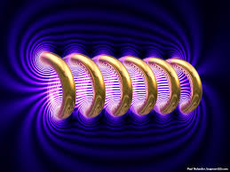
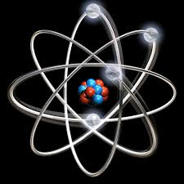

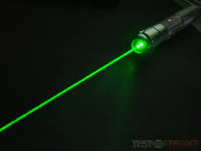


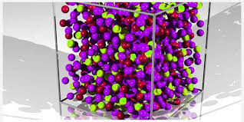
Engineering Physics
PHY-110
Solid State Physics
ELECTROMAGNETIC THEORY
QUANTUM MECHANICS
LASER
WAVES
Dr. Jeeban Pd Gewali
Department of Physics
Lovely Professional University
Phagwara, Punjab-144411
SOLID STATE PHYSICS
FIBER OPTICS

Slide 2
Syllabus
Free electron theory (Introduction).
Diffusion and drift current (qualitative).
Fermi energy, Fermi-Dirac distribution function.
Band theory of solids - formation of allowed and forbidden energy bands.
Semiconductors and insulators, Fermi level for intrinsic and extrinsic semiconductors.
Direct and indirect band gap semiconductors.
Concept of effective mass - electrons and holes.
Hall effect (with derivation).

Slide 3

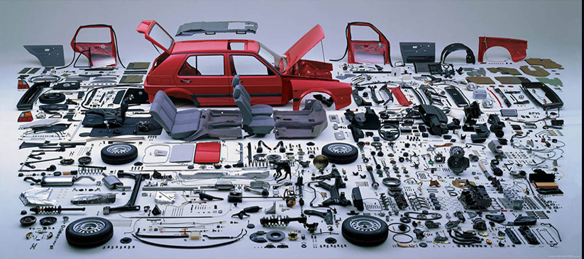

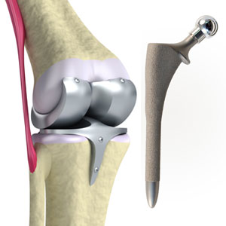

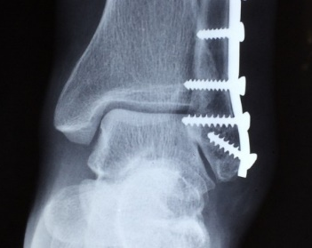
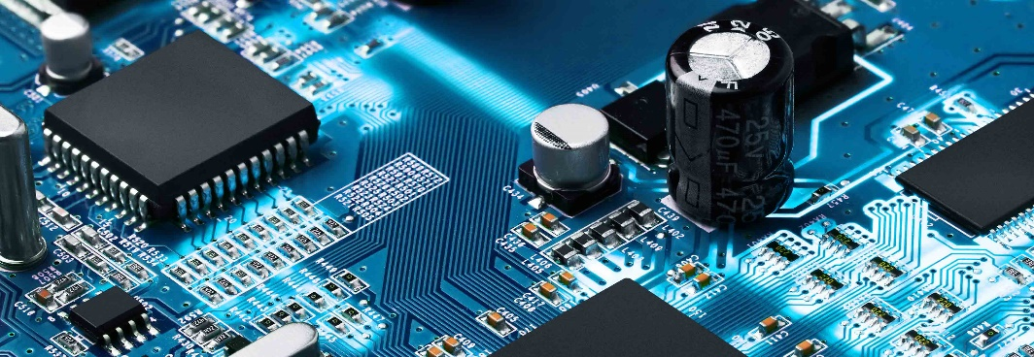

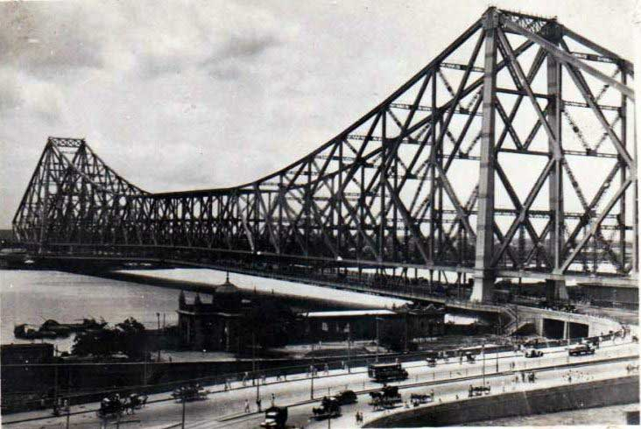
Solid
Metals:
Na, Fe, Cu, Al, Au, Ag, Ti, Ni, Pt etc.
Semiconductor/Insulators:
Si, Ge, GaAs, BN, Al₂O₃, ZnO, TiO₂, SiO₂, CdTe, PbS, ZnS etc.

Slide 4
Metals
The simplest metals are the alkali metals with one valence electrons such as Na, K, Li etc.
The electronic configuration of sodium is Na- 1s² 2s² 2p⁶ 3s¹.
The last electron behaves as a conduction electrons in metal which is also called the free electron.
The free electron behaves like the molecules in a perfect gas and are called free electron gas.
The free electron theory considers the force between the conduction electrons and the ion cores are neglected so that the total energy of the electron is all kinetic and the potential energy is taken to be zero. Therefore the motion of the electrons within the metal is free because there are no collisions, similar to the molecules of an ideal gas.
It was believed that many physical properties of metals including electrical and thermal conductivities can be understood by considering free electron model. The works of Lorentz and Drude are important to cite here.
Free electron theory https://www.youtube.com/watch?v=ttdtdLfn9HU

Slide 5
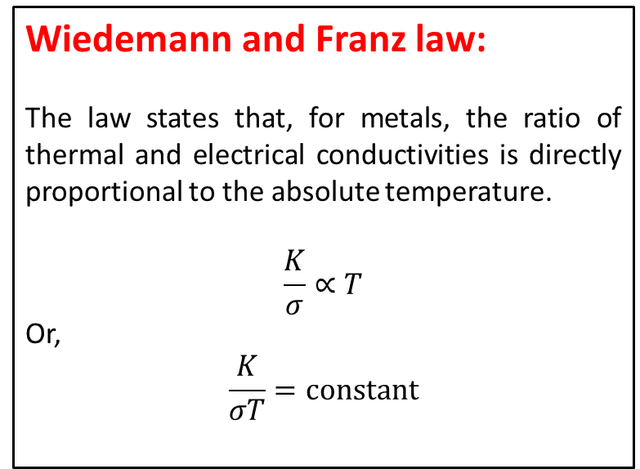
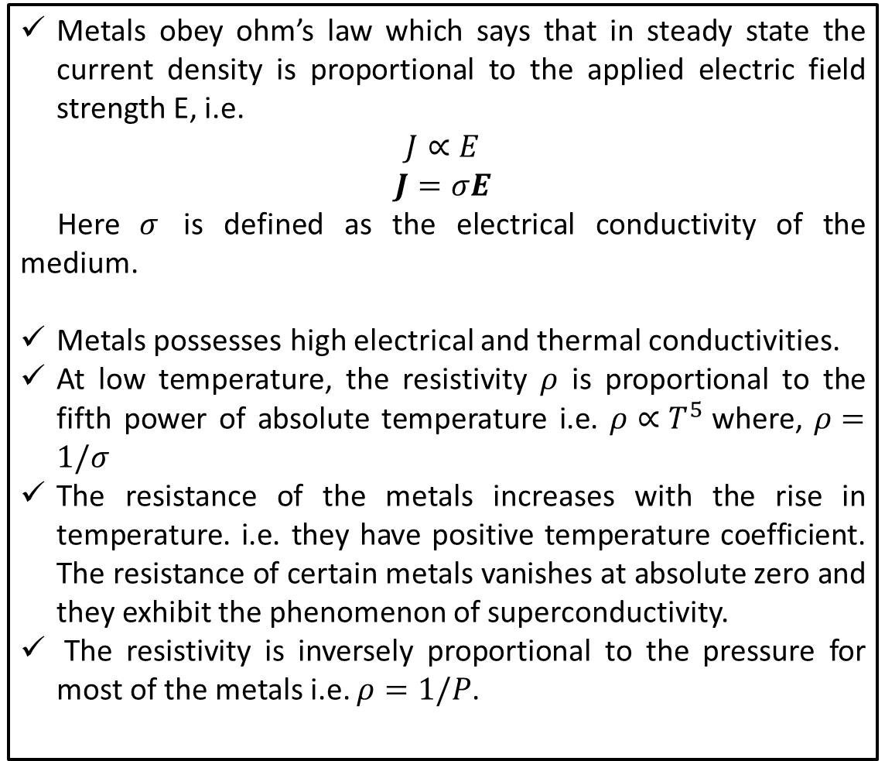
Properties of Metals
Metals obey ohm’s law which says that in steady state the current density is proportional to the applied electric field strength E, i.e.
$$J∝E$$
$$J=σE$$
Here $σ$ is defined as the electrical conductivity of the medium.
Metals possesses high electrical and thermal conductivities.
At low temperature, the resistivity $ρ$ is proportional to the fifth power of absolute temperature i.e. $ρ∝T^{5}$where, $ρ=1/σ$
The resistance of the metals increases with the rise in temperature. i.e. they have positive temperature coefficient. The resistance of certain metals vanishes at absolute zero and they exhibit the phenomenon of superconductivity.
The resistivity is inversely proportional to the pressure for most of the metals i.e. $ρ=1/P$.
Wiedemann and Franz law:
The law states that, for metals, the ratio of thermal and electrical conductivities is directly proportional to the absolute temperature.
$$\frac{K}{σ}∝T$$
Or,
$$\frac{K}{σT}=constant$$

Slide 6
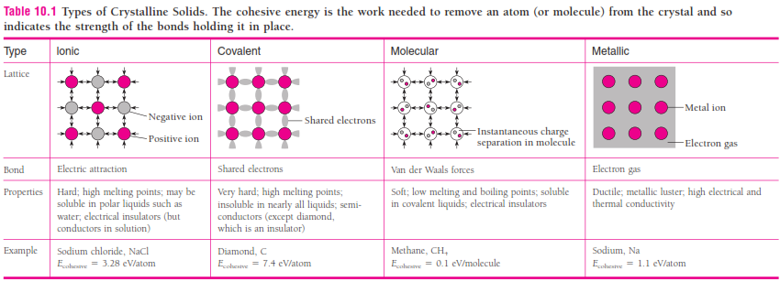
Comparison of bonds

Slide 7
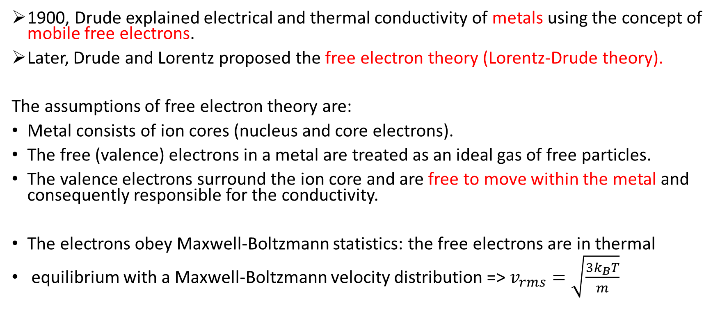
Classical Picture and Lorentz-Drude Model
1900, Drude explained electrical and thermal conductivity of metals using the concept of mobile free electrons.
Later, Drude and Lorentz proposed the free electron theory (Lorentz-Drude theory).
The assumptions of free electron theory are:
Metal consists of ion cores (nucleus and core electrons).
The free (valence) electrons in a metal are treated as an ideal gas of free particles.
The valence electrons surround the ion core and are free to move within the metaland consequently responsible for the conductivity.
The electrons obey Maxwell-Boltzmann statistics: the free electrons are in thermal
equilibrium with a Maxwell-Boltzmann velocity distribution =>$v_{rms}=\sqrt{\frac{3k_{B}T}{m}}$
Maxwell boltzmann statistics
https://www.youtube.com/watch?v=xQ9D4Jz95-A

Slide 8
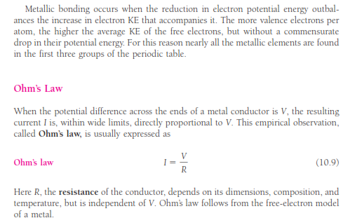
Ohm’s Law

Slide 9
Classical Picture and Lorentz-Drude Model
We begin by assuming that
the free electrons in a metal, like the molecules in a gas, move in random directions and undergo frequent collisions.
These collisions are not billiard-ball collisions with other electrons but represent the scattering of Electron waves by irregularities in the crystal structure, both defects such as impurity atoms and also atoms temporarily out of place as they vibrate.
As we will see later, the Atoms of a perfect crystal lattice do not scatter free Electron waves except under certain specific circumstances.

Slide 10
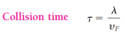
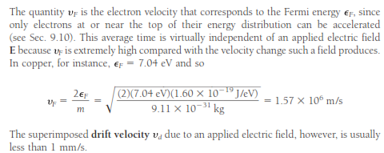
Electrical Properties of Metals
If λ is the mean free path between the collisions of a free electron, the average time between collisions is

Slide 11
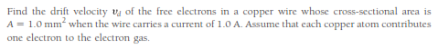
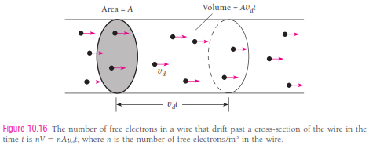
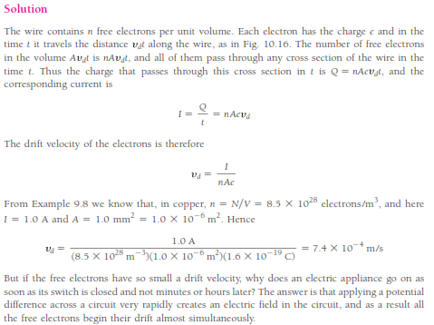
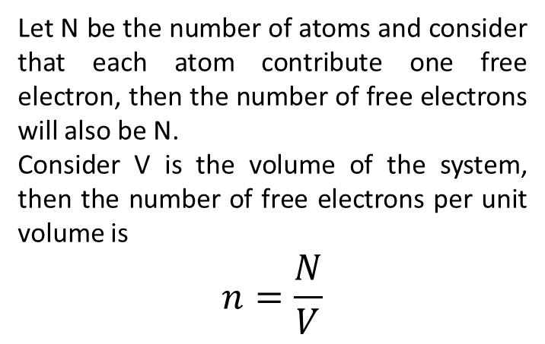
Let N be the number of atoms and consider that each atom contribute one free electron, then the number of free electrons will also be N.
Consider V is the volume of the system, then the number of free electrons per unit volume is
$$n=\frac{N}{V}$$
Drift velocity
https://www.youtube.com/watch?v=qg0JY4GNK0w

Slide 12

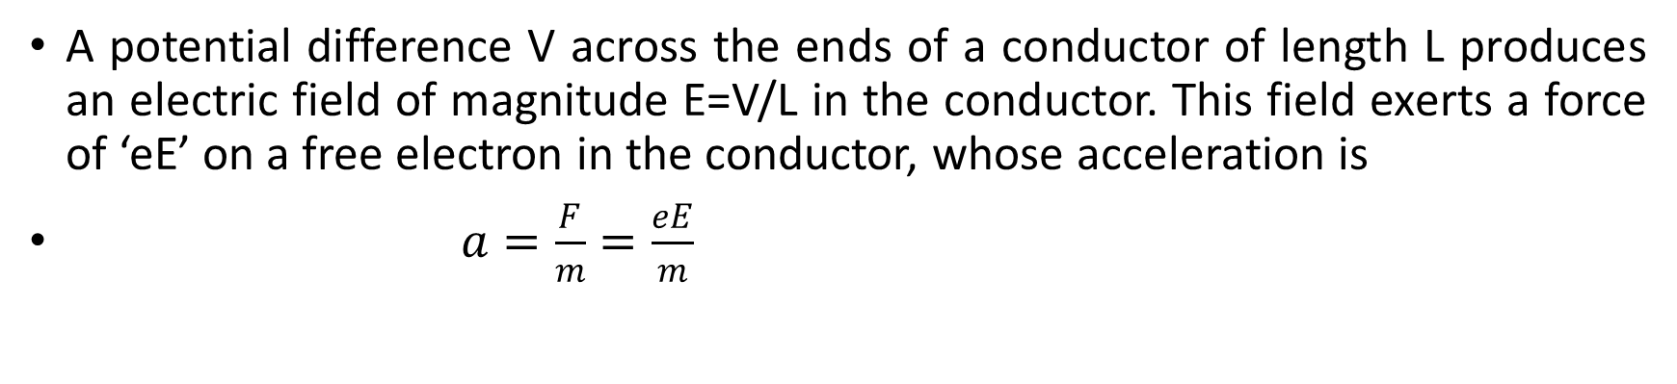
Electrical Properties of Metals
A potential difference V across the ends of a conductor of length L produces an electric field of magnitude E=V/L in the conductor. This field exerts a force of ‘eE’ on a free electron in the conductor, whose acceleration is
$a=\frac{F}{m}=\frac{eE}{m}$
An electric field produces a general drift superimposed on the random motion of a free electron. The electron’s path between collisions is actually slightly curved because of the acceleration due to the field.
When the electron undergoes a collision, it bounce back in an arbitrary direction and on the average, no longer has a component of velocity parallel to E. Imposing the field E on the free electron gas in a metal superimposes a general drift on the faster but random motions of the electron. We can therefore ignore the electron’s motion at the Fermi velocity in calculating the drift velocity v_{d}.

Slide 13
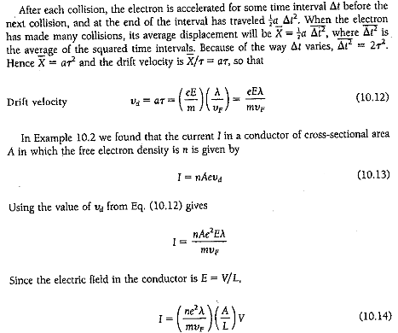
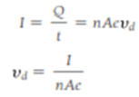
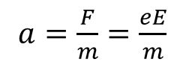
Electrical Properties of Metals
$$a=\frac{F}{m}=\frac{eE}{m}$$

Slide 14
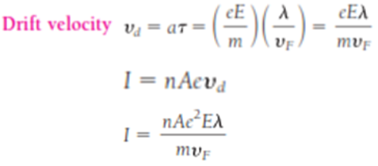
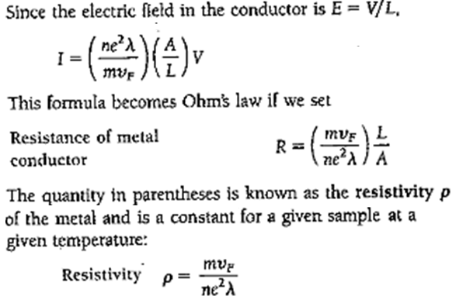
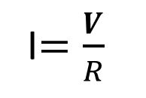
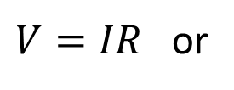
Electrical Properties of Metals
$V=IR$ or
I$=\frac{V}{R}$

Slide 15
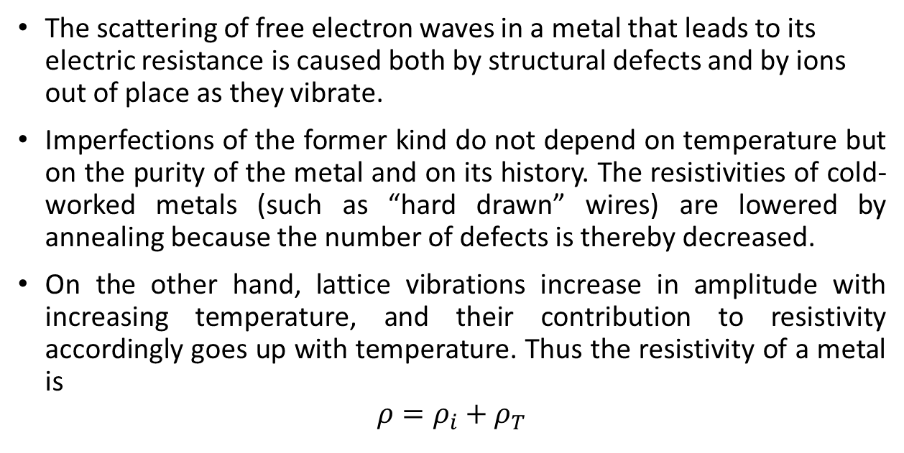
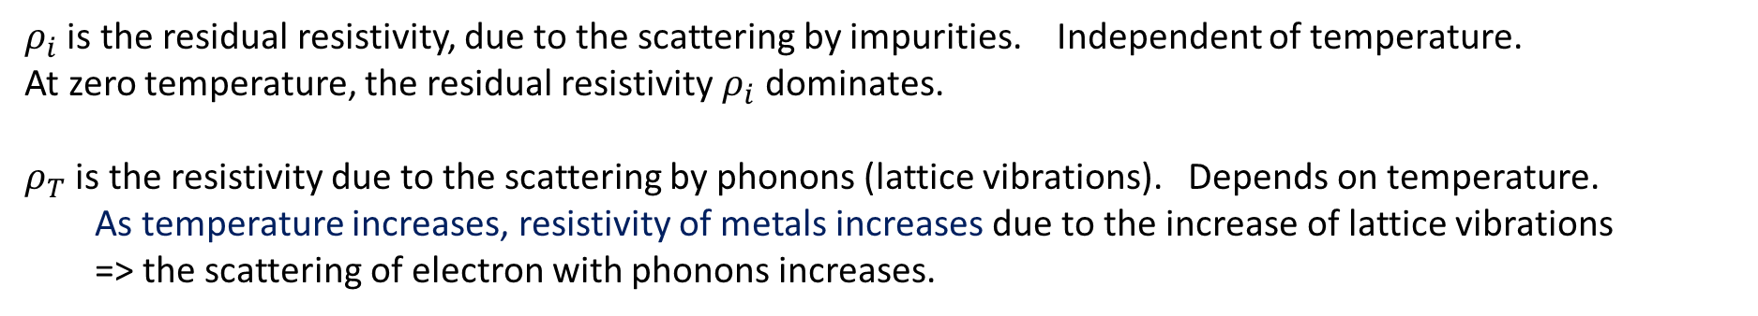
Electrical Properties of Metals: Resistivity
The scattering of free electron waves in a metal that leads to its electric resistance is caused both by structural defects and by ions out of place as they vibrate.
Imperfections of the former kind do not depend on temperature but on the purity of the metal and on its history. The resistivities of cold-worked metals (such as “hard drawn” wires) are lowered by annealing because the number of defects is thereby decreased.
On the other hand, lattice vibrations increase in amplitude with increasing temperature, and their contribution to resistivity accordingly goes up with temperature. Thus the resistivity of a metal is
$$ρ=ρ_{i}+ρ_{T}$$
$ρ_{i}$ is the residual resistivity, due to the scattering by impurities. Independent of temperature.
At zero temperature, the residual resistivity $ρ_{i}$ dominates.
$ρ_{T}$ is the resistivity due to the scattering by phonons (lattice vibrations). Depends on temperature.
As temperature increases, resistivity of metals increases due to the increase of lattice vibrations
=>the scattering of electron with phonons increases.

Slide 16
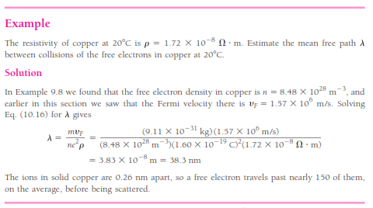
𝑛=𝑁/𝑉

Slide 17
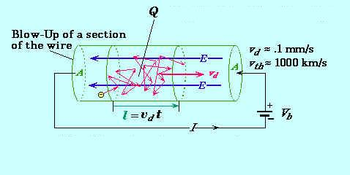
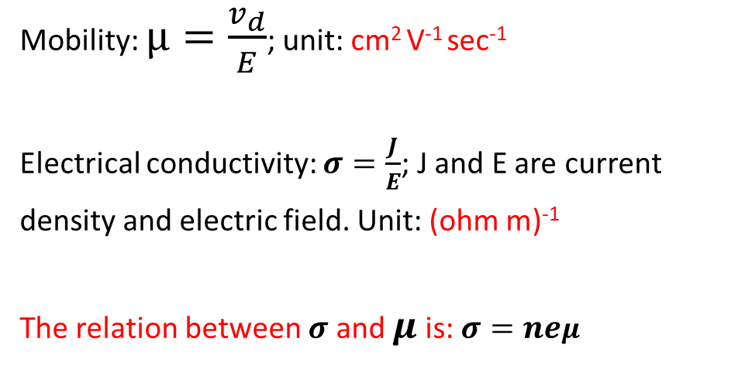
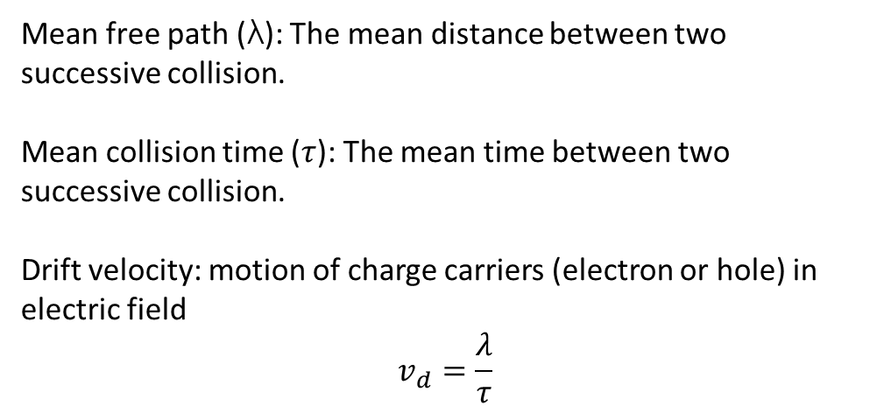
Electrical Properties of Metals
Mean free path (λ): The mean distance between two successive collision.
Mean collision time ($τ$): The mean time between two successive collision.
Drift velocity: motion of charge carriers (electron or hole) in electric field
$$v_{d}=\frac{λ}{τ}$$
Mobility: $μ=\frac{v_{d}}{E}$; unit: cm² V⁻¹ sec⁻¹
Electrical conductivity: $σ=\frac{J}{E}$; J and E are current
density and electric field. Unit: (ohm m)⁻¹
The relation between $σ$ and $μ$ is: $σ=neμ$
Electron mobility is the measure of how fast an electron can move through a metal or semiconductor under the influence of external electric field.
Mobility μ is defined as the magnitude of drift velocity per unit electric field. μ=E∣vd∣.

Slide 18
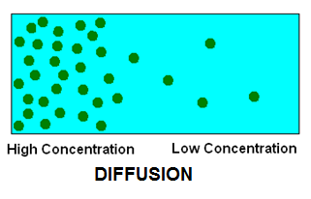
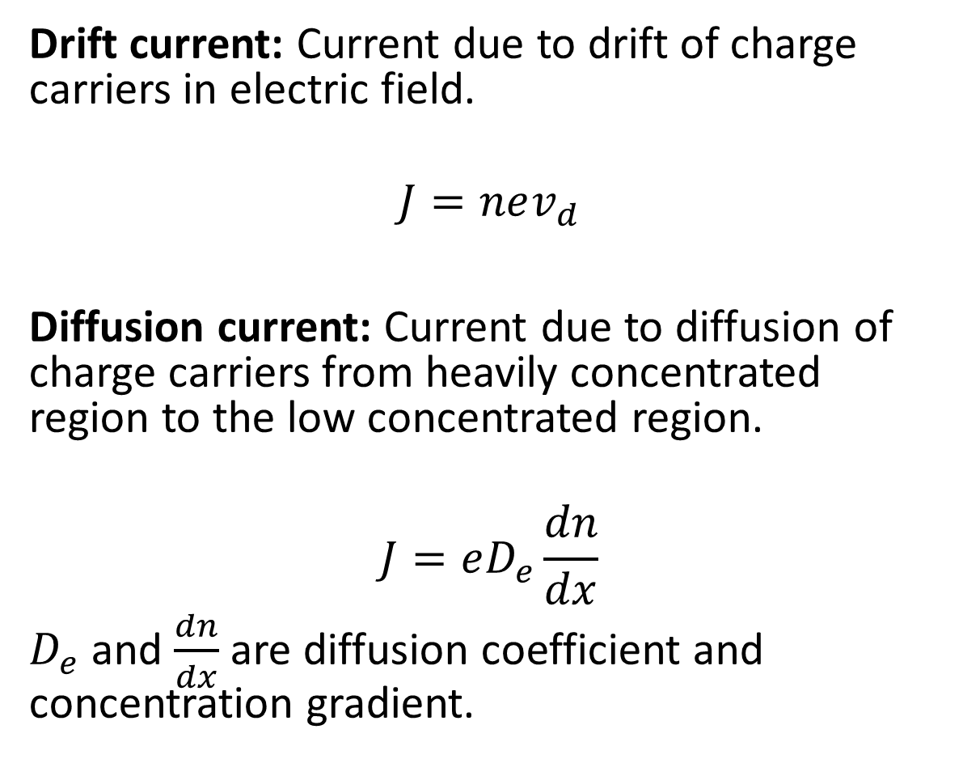
Electrical Properties of Metals
Drift
Drift current: Current due to drift of charge carriers in electric field.
$$J=nev_{d}$$
Diffusion current:Current due to diffusion of charge carriers from heavily concentrated region to the low concentrated region.
$$J=eD_{e}\frac{dn}{dx}$$
$D_{e}$ and $\frac{dn}{dx}$ are diffusion coefficient and concentration gradient.

Slide 19
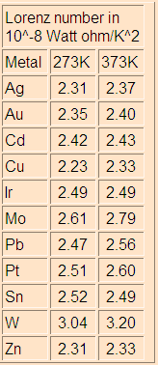
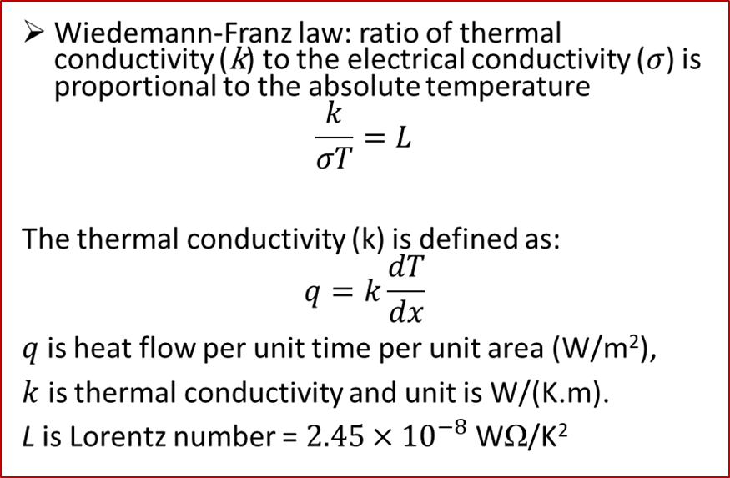
Wiedemann-Franz Law (1853)
(Ludwig) Lorenz Number
(derived via quantum mechanical treatment)
N/V
×10²² /cm³
k_{F}
×10⁸ /cm
v_{F}
×10⁸ cm/s
ε_{F}
eV
T_{F}
×10⁴ K
Li | 4.70 | 1.11 | 1.29 | 4.72 | 5.48
Na | 2.65 | 0.92 | 1.07 | 3.23 | 3.75
Cu | 8.45 | 1.36 | 1.57 | 7.00 | 8.12
Au | 5.90 | 1.20 | 1.39 | 5.51 | 6.39
Be | 24.20 | 1.93 | 2.23 | 14.14 | 16.41
Al | 18.06 | 1.75 | 2.02 | 11.63 | 13.49
Pb | 13.20 | 1.57 | 1.82 | 9.37 | 10.87
Notes:
19

Slide 20
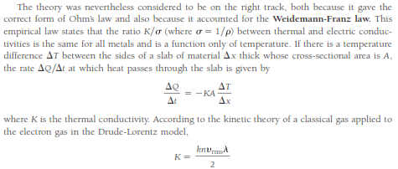
Wiedemann-Franz law

Slide 21
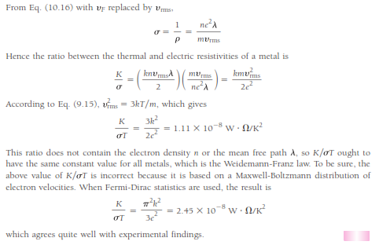
Wiedemann-Franz law

Slide 22
Statistical Distributions
E:- total energy of the system; N:- total number of particles in the system
E is distributed among N particles of the system at absolute temperature T.
N remains constant except for the system of photons or phonons.
ε₁, ε₂, ε₃, ε₄, ε₅, ε₆, …….., ε_{n}
n₁, n₂, n₃, n₄, n₅, n₆, …………, n_{n}
E = n₁ε₁+ n₂ε₂+ n₃ε₃+ n₄ε₄+ ……..+ n_{n}ε_{n}
N = n₁, n₂, n₃, n₄, n₅, n₆, …………, n_{n}
The number of particles n(ε ) with energy ε
And n(ε) = g(ε) f(ε),
where f(ε) is distribution function. It gives average number of particles in each state of energy ε i.e. the probability of occupancy of each state of energy ε and
G(ε) is the number of states in the energy ε. Statistical weight corresponding to each energy ε.
For continuous distribution g(ε) is replaced by g(ε)d ε. And the number of states with an energy between ε and ε+d ε.

Slide 23
Statistical distributions
Maxwell–Boltzmann statistics
Bose–Einstein statistics
Fermi–Dirac statistics

Slide 24
Statistical Distributions
Maxwell–Boltzmann statistics describes the average distribution of non-interacting material particles over various energy states in thermal equilibrium, and is applicable when the temperature is high enough or the particle density is low enough to render quantum effects negligible.
Bose–Einstein statistics is one of two possible ways in which a collection of non-interacting indistinguishable particles may occupy a set of available discrete energy states, at thermodynamic equilibrium.
Fermi–Dirac statistics describe a distribution of particles over energy states in systems consisting of many identical particles that obey the Pauli exclusion principle.

Slide 25
Three Statistics
Sr. No. | Maxwell_Boltzmann | Bose-Einstein distribution | Fermi-Dirac distribution
1 | Identical particles | Identical particles | Identical particles
2 | Molecules of gas e.g. oxygen, carbon dioxide etc. | Bosons, particles with 0 or integral spin (1,2,3,4,5,….) | Fermions, particles with odd half integral spins i.e. ½, 3/2, 5/2, ……..
3 | Do not obey Pauli’s exclusion principle, any number of particles can exist in the same quantum state of system | Do not obey Pauli’s exclusion principle, any number of particles can exist in the same quantum state of system | Obey Pauli’s exclusion principle, only one fermion can exist in a particular quantum state of system
4 | Sufficiently apart and distinguishable | Indistinguishable and not sufficiently apart | Indistinguishable and not sufficiently apart
5 | Wavefunctions do not overlap or overlap to negligible extent | Wavefunctions overlaps Wavefunction of system is not affected by exchange of any pair of particles | Wavefunctions overlap and wavefunction changes sign upon exchange of any pair

Slide 26
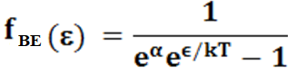
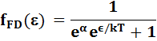
Three Statistics
Sr. | Maxwell_Boltzmann | Bose-Einstein distribution | Fermi-Dirac distribution
6 | Wavefunctions do not overlap or overlap to negligible extent | Wavefunctions overlaps Wavefunction of system is not affected by exchange of any pair of particles | Wavefunctions overlap and wavefunction changes sign upon exchange of any pair
7 | --------- | Symmetric wavefunction | Anti-Symmetric
8 | n(ε) = A g(ε) e^{-ε/kT}, g(ε) is the partition function
9 | Maxwell-Boltzman distribution function f_{MB}(ε) = A e^{-ε/kT}, constant depends on the number of particles in the system | Bose-Einstein distribution function , Constant alpha depends on the properties of particular system and may be a function of temperature | Fermi-Dirac distribution function Constant alpha depends on the properties of particular system and may be a function of temperature
10 | No limit to the number of particles per state | No limit to number of particles per state, more particles per state than f_{MB} at low energies; approaches f_{MB} at high energies | Never more than 1 particle per state, fewer particles per state than f_{MB} at low energies; approaches f_{MB} at high energies

Slide 27
Distribution functions
The probablity f(ε) that a boson occupies a state of energy ε turns to be
Bose Einstein distribution function
The probability for a fermions turns to be
Fermi Dirac distribution function

Slide 28
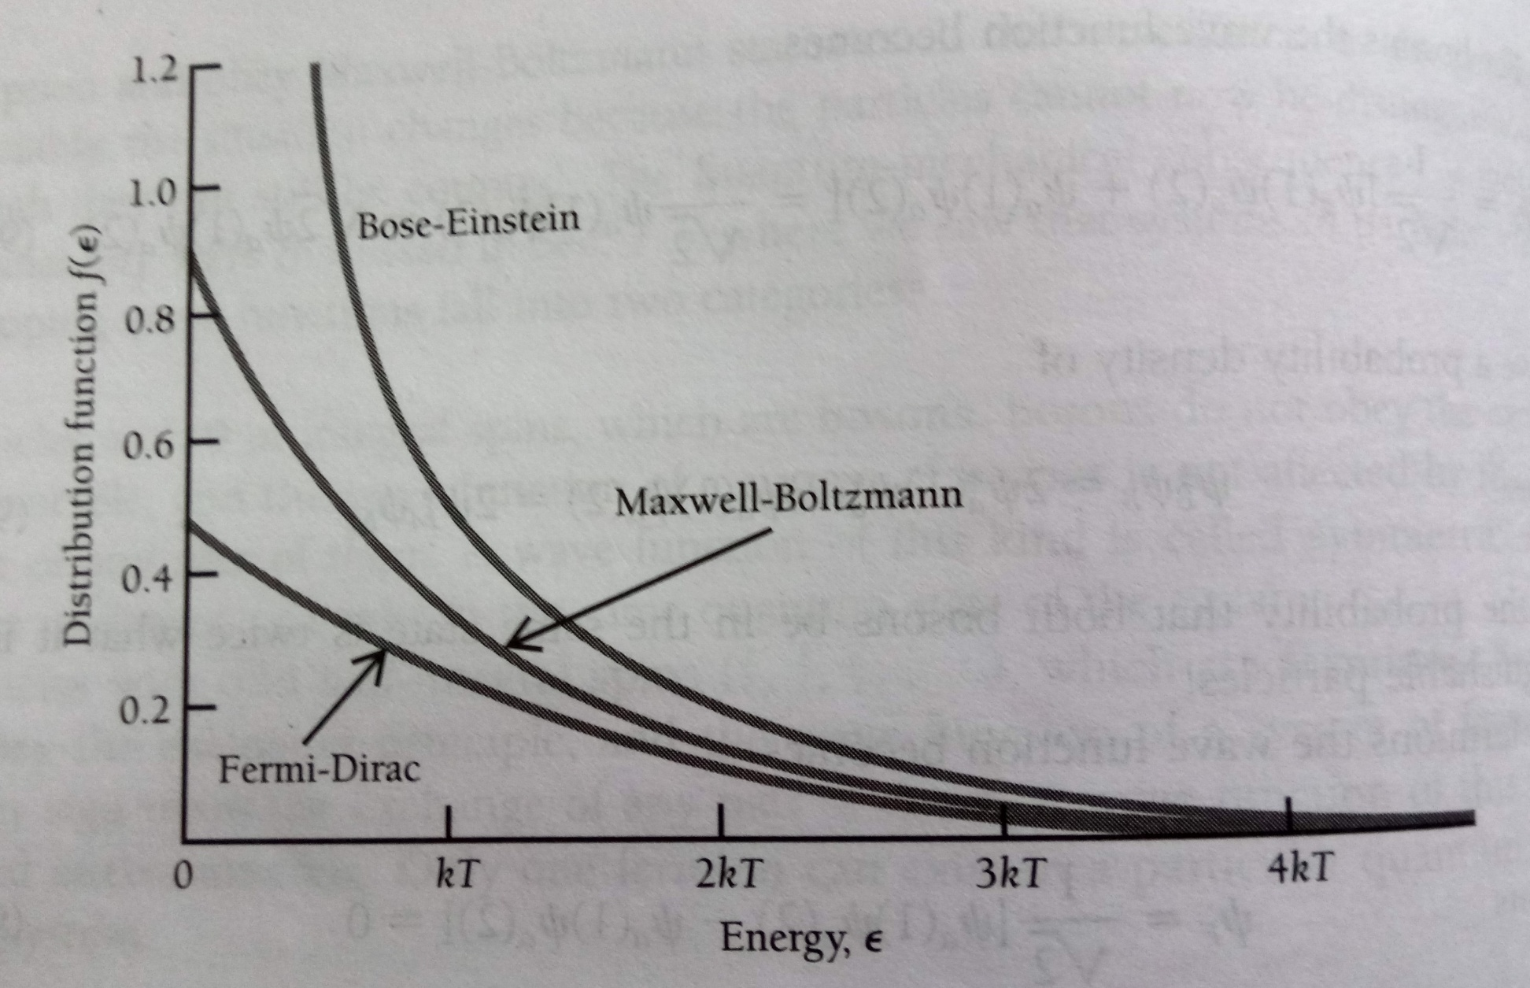
Comparison of three distribution functions
f_{MB}(ε) = A e^{-ε/kT}

Slide 29
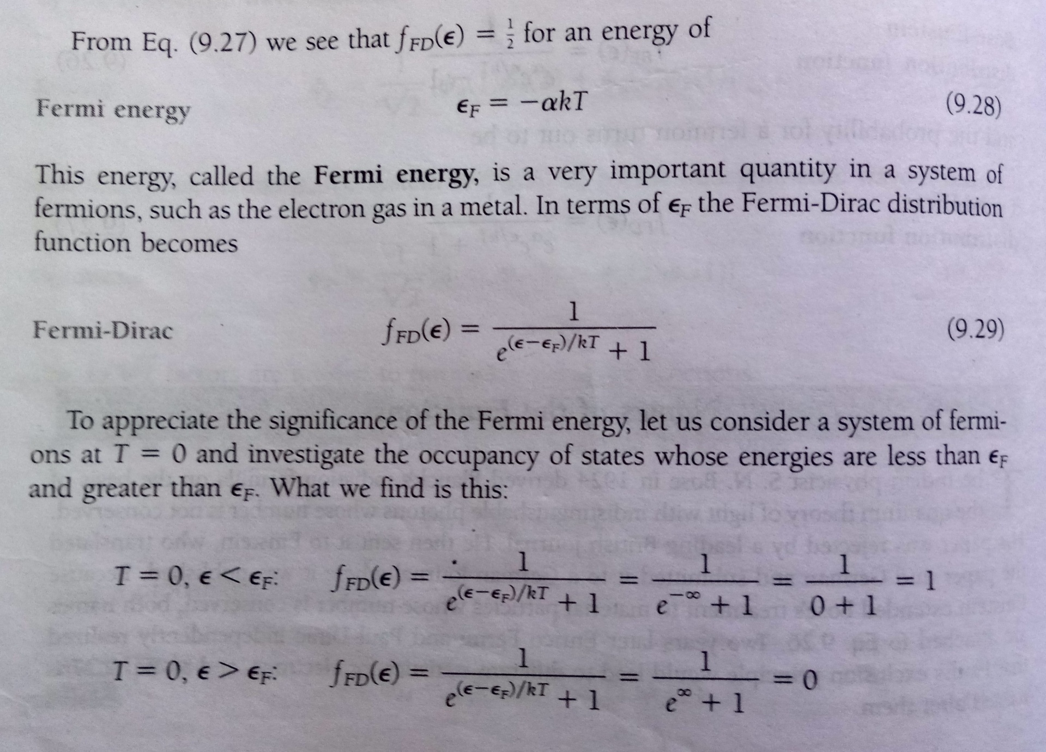

Slide 30
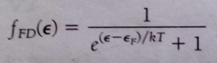
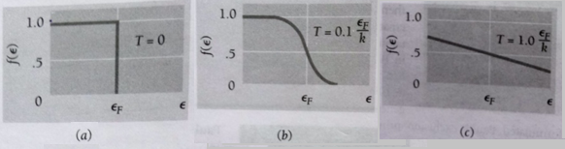
Distribution function for fermions at three different temperatures
(a) at T = 0, all the energy states up to the Fermi energy ε_{F} are occupied.
(b) AT low temperature, some fermions will leave states just below the ε_{F} and move into states just above ε_{F}.
(c) AT higher temperature, some fermions from any state below the ε_{F} may move into states above ε_{F}.
https://www.youtube.com/watch?v=ZWUiDL4cgC0

Slide 31
Band Theory of Solids
For an isolated atom, the electrons can have discrete energy levels. For hydrogen, the energy levels are described as $E_{n}=−\frac{13.6}{n^{2}}$, where n is the principal quantum number.
Let us consider one single isolated hydrogen atom. The wave function of an electron in the atom in the ground state is $u\left(r\right)={\left(πa_{0}^{3}\right)}^{−\frac{1}{2}}\exp\left(−\frac{r}{a_{0}}\right)$, $a_{0}$ is the first Bohr’s radius.
Let us now assume that two such atoms are brought close together. Let $u_{1} and u_{2}$ denote the electronic wave functions for the atoms when they are far apart and are not influenced by one another.
U₁
U₂
U₁
B
A
B
A
U₂
As the separation between the atoms is decreased, the wave functions $u_{1}$ and $u_{2}$ overlap and the resultant electronic wave functions may be $u_{1}+u_{2}$ or $u_{1}−u_{2}$.
$$u_{1}+u_{2}$$
U₁
B
A
B
A
$$u_{1}−u_{2}$$
U₂

Slide 32
Band Theory of Solids
U₁
B
A
B
A
U₂
For the wave function $u_{1}+u_{2}$ the electron has a finite probability to be found midway between the two nuclei. In this region the binding energy increases since the electron experiences the binding force of both the nuclei.
For the wave function $u_{1}−u_{2}$, the probability density is zero midway between the two nuclei so that extra contribution of energy disappears. Thus, there is a difference in energy between the states $u_{1}+u_{2}$ and $u_{1}−u_{2}$. This means that as the two atoms are brought close together, each energy state splits into two distinct energy states.
Similarly, if N atoms are brought close together, each energy level will split into N number of energy states.
When N is large, the separation between the energy states is very small and they may be thought of to form a quasi-continuous energy band.
Thus each energy levels, may be considered to split into a band of energy levels. The width of the band depends upon the strength of interaction and overlap between the neighboring atoms.
2s
Energy
1s
Distance between the atoms

Slide 33
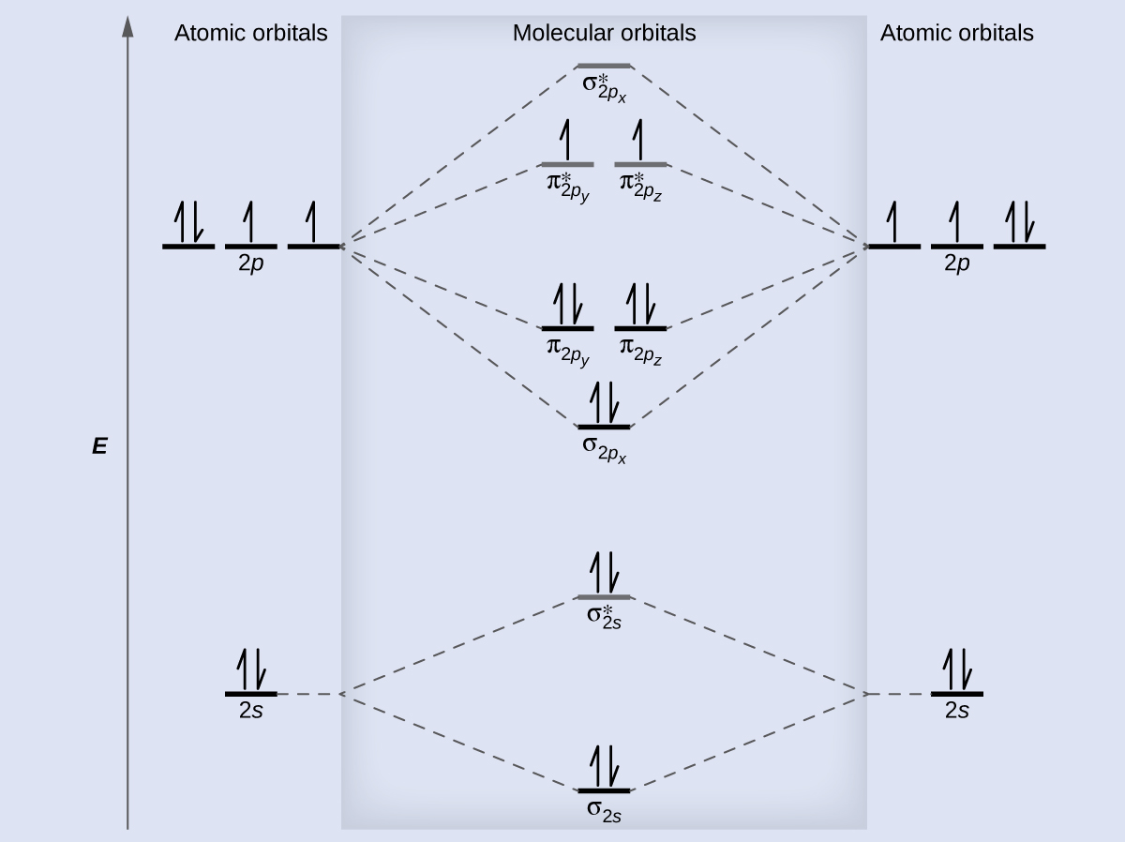
Molecular Orbitals

Slide 34
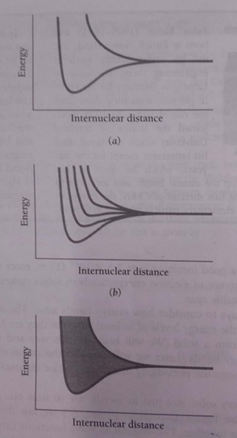
The 3s level is the highest occupied level in a ground state sodium atom.
(a) When two sodium atoms come close together, their 3s levels initially equal, becomes two separate levels because of the overlap of the corresponding electron wave functions.
(b) The number of new levels equals the number of interacting atoms.
(c) When the number of interacting atoms is very large, as in solid sodium, the result is an energy band of very closely spaced levels.

Slide 35
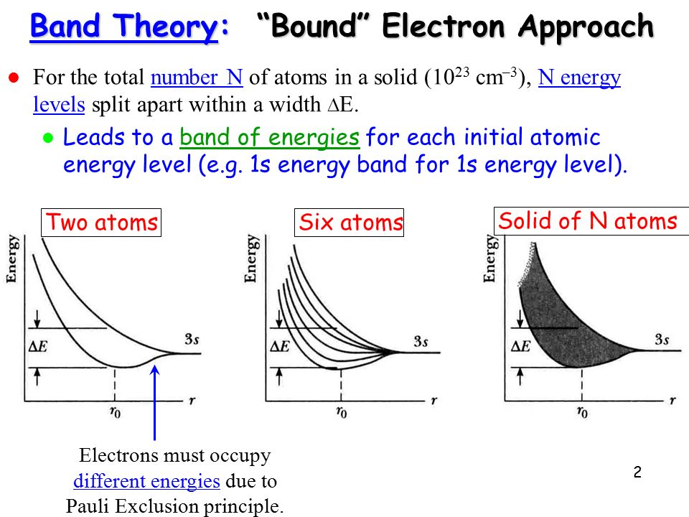

Slide 36
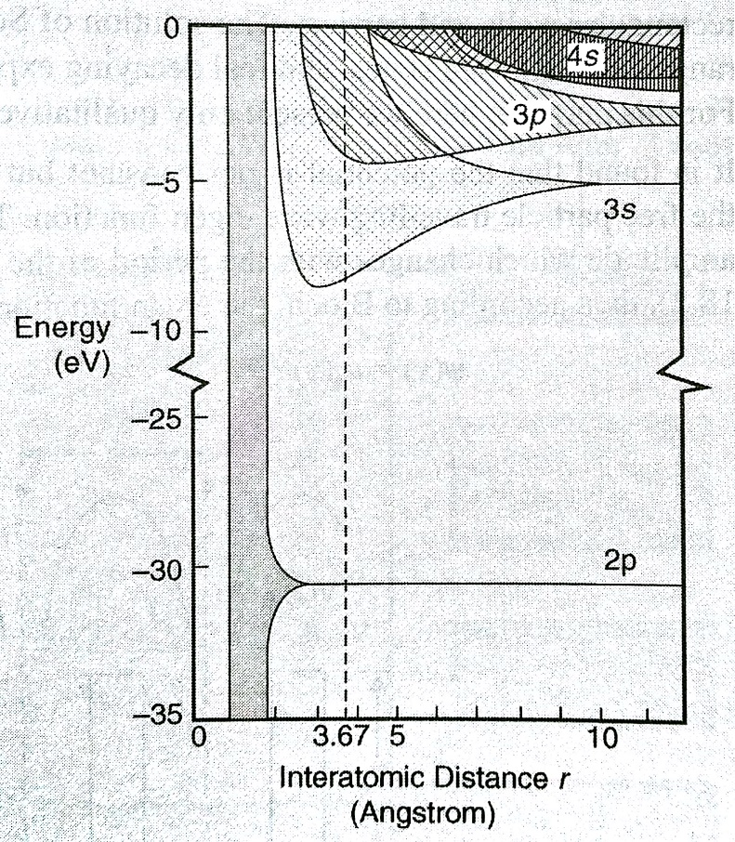
Formation of Allowed and Forbidden Bands
The electronic configuration of sodium is plotted in the side figure.
The dashed vertical line represents the equilibrium interatomic distance.
It is clear from the figure that the band overlaps as the interatomic distance decreases.
The allowed band corresponding to the inner subshell e.g. 2p are extremely narrow and does not begin to split until the interatomic distance r becomes less than the value actually found in the crystal.
As we move towards the high energy states, the energy of the electrons become larger and also the region in which they can mover become wider. Since they are also affected more by the nearby ions, it is seen that the bands become progressively wider for the outer occupied subshells and also for the unoccupied subshells of the atom in its ground state.
An electron in a solid can occupy only energy that falls within these energy bands. The overlapping of the bands depends on the structure of the solid. If the band do not overlap, then the intervals between them represents energies which the electrons in he solid cannot occupy. These intervals are called the forbidden bands or energy gaps.

Slide 37
Na(Sodium) Versus Mg(Magnesium)
The electronic configuration of sodium is 1s² 2s² 2p⁶ 3s^{1.} In sodium (a good conductor) there are 2 electron states per atom in the 3s shell. However only one of them is filled with a single valence electron. As a result the 3s shell is only half filled. The electron is free to change its energy within the 3s band. This allows the electrons to pick up a kinetic energy from an applied electric field leading to a drift velocity generating current that makes Na a good metallic conductor. | Magnesium has an electronic configuration 1s² 2s² 2p⁶ 3s². Thus it has a filled 3s shell and on its own it would not allow for the electrons to gain energy, if the 3p band was separated by a gap from the 3s band. In magnesium however, the 3s and3p band overlap in energy. The 3p band can accommodate 6 electrons. Thus jointly the 3s and 3p orbitals form a band that can accommodate 8 electrons out of which only 2 are there. Thus the conduction band is only 25% filled and hence Mg is also a good conductor of electricity.

Slide 38
Band in Insulators
Carbon
In insulators the electron states in the valence band are completely filled.
The next higher available energy band, the conduction band, is separated from the valence band by a band gap.
In an insulator the band gap is large enough in energy so that electrons are not thermally excited across it.
Carbon (C, 1s² 2s² 2p²) is an insulator even though it has a only partially filled p band.
At some intermediate C-C separation an overlapping s-p band accommodating 8N electron states is formed.
At the equilibrium separation however the band is split into two bands accommodating 4N electrons (hybridization) each that are separated by an energy gap of 6 eV making Carbon (diamond) an insulator.

Slide 39
Band in Semiconductors
similar reasoning applies to silicon (Si, 1s² 2s² 2p⁶ 3s² 3p²).
For Si the energy gap is only 1 eV.
At room temperature a noticeable number of electrons are thermally excited across the energy gap, where states are available and electrons can gain energy and conduct current.
Because of the intermediate conductivity such materials are called semiconductors
Valence Band:-The band of energy occupied by the valence electrons is called the valence band. The valence band is the highest occupied band.
Conduction Band:-The conduction band is normally empty and may be defined as the lowest unfilled energy band. In the conduction band, electrons can move freely and are generally called conduction electrons.

Slide 40
What is so special about the valence and conduction band?
In ideal cases the conduction band is empty and the valence band is fully occupied. Hence, when the electrons move from the valence band to the conduction band, gaining some energy from the external source, the electron become free to roam about in the conduction band. This is why conduction band is responsible for the conduction of electricity. The electrons can occupy any energy state within this conduction band of energies.
Pauli's exclusion principle however, forbids two electrons to occupy same energy state. If one electron takes one energy state, then other electrons in the same band now have less number of unoccupied states to move to.
So, if more electrons are brought to the conduction band, less freedom each of them has, to move around within this band. If it becomes totally full, they are all again "fixed" at their current energy states and the freedom is lost. Thus, once again some amount of energy has to be added to make a jump to even higher band to reach freedom again.
At this point, the recently full conduction band has become "the new" valence band. And "the new" conduction band is the nearest band higher up (energy-wise). There is thus no difference between valence and conduction bands other than how much occupied they are.
https://physics.stackexchange.com/questions/266114/what-is-it-about-the-conduction-band-of-a-material-that-is-distinct-from-the-v

Slide 41

Band Formation in Silicon
In a solid, many atoms are brought together, so that the split energy levels form essentially continuous bands of energies.
Each isolated silicon atom has an electronic structure
1s² 2s² 2p ⁶ 3s² 3p² in the ground state.
Each atom has available two Is states, two 2s states, six 2p states, two 3s states, six 3p states, and higher states.
If we consider N atoms, there will be 2N, 2N, 6N, 2N, and 6N quantum states of type Is, 2s, 2p, 3s, and 3p, respectively.
As the interatomic spacing decreases, these energy levels split into bands, beginning with the outer (n = 3) shell.
As the "3s" and "3p" bands grow, they merge into a single band composed of a mixture of energy levels. This band of "3s-3p" levels contains 8N available quantum states.

Slide 42
Band Formation in Silicon
As the distance between atoms approaches the equilibrium interatomic spacing of silicon, this band splits into two bands separated by an energy gap Eg.
The upper band (called the conduction band) contains 4N quantum states, as does the lower (valence) band.
Thus, apart from the low-lying and tightly bound "core" lev­els, the silicon crystal has two bands of available energy levels separated by an energy gap E_{g} wide, which contains no allowed energy levels for electrons to occupy.
This gap is sometimes called a "forbidden band," since in a perfect crystal it contains no electron energy states.

Slide 43


Band Formation in Silicon

Slide 44

Formation of bands in Silicon
The core levels (n = 1,2) in Si are completely filled with electrons.
At the actual atomic spacing of the crystal, the 2N electrons in the 3s subshell and the 2N electrons in the 3p subshell undergo sp² hybridization, and
ll end up in the lower 4N quantum states (va­lence band), while the higher-lying 4N quantum states (conduction band) are empty, separated by a band gap.

Slide 45


Band gap in the solids

Slide 46

Insulators
The band formation for the insulators is as shown in the figure.
The forbidden gap between the highest filled band and the lowest empty band is very wide and is about 3 eV to 6 eV.
Very few electrons from the filled band reach the empty band even if we thermally excite them or apply an electric field to them.
The Pauli’s exclusion principle restricts the electrons from moving in the valence band. Hence a free electron current cannot be obtained for the insulating material.
Ex- diamond, quartz, ZnO, Agcl etc.

Slide 47

Semiconductors
In this case of semiconductors, the forbidden band between the highest filled valence band and the lowest empty conduction band is very narrow and is about 0.1 eV to 1 eV.
Thus, we can easily move the electrons from the highest filled band to the empty band. This can be achieved by thermal excitation or by applying electric field. For this reason, a free electron current can be obtained as a few electrons are available in the empty band.

Slide 48
Intrinsic versus Extrinsic Semiconductors
The conductivity of an intrinsic semiconductor can be increased significantly by adding impurities to it. By doing so we get impurity semiconductor which is also known as extrinsic semiconductor.
The introduction of the impurity to a semiconductor is called doping and the impurity which is introduced is called dopant.
The impurity atoms creates excess holes or the free electrons which control the conductivity of the extrinsic semiconductor.
Depending on the nature of the dopant and extrinsic semiconductor may be classified as an n-type or a p-type semiconductor.
If an element of group III is introduced to Ge or Si, excess holes are generated which results in a p-type semiconductor.
If an element of group V is introduced to Ge or Si, excess holes are generated which results in an n-type semiconductor.
The semiconductor in which the transformation of electrons to the conduction band and the generation of holes in the valence band are achieved purely by thermal excitation are called intrinsic semiconductors. Thus, this effect is temperature dependent and produces equal number of electron and hole carriers. The electrons and holes are called intrinsic charge carriers and the resulting conductivity is known as thermal conductivity.
In intrinsic semiconductor, the number of holes and electrons must be the same.
Intrinsic carrier concentration increases with increase in temperature.
Ge and Si are intrinsic semiconductor.

Slide 49


Conductivity in Ge and Si (Intrinsic Semiconductor)
Si or Ge is a group IV element of the periodic table and each atom has four valence electrons. The valence electrons of a particular atom are held by covalent bonds with the valence electrons of four neighboring atoms. When a valence electron gets sufficient energy, it breaks its covalent bond and become free. The vacancy left behind by the electron serves as a hole. Thus a free electron and a hole is created. An adjacent valence electron such as that in position A may acquire sufficient thermal energy and jump into the position of the hole to reconstruct the broken bond. However, in doing so, it breaks its own covalent bond, creating a new hole there. Thus effectively the hole moves to the position A and not only the free electron but also the hole it creates can move about the crystal.

Slide 50


Fermi Levels
Intrinsic Semiconductor:
For an intrinsic semiconductor, Fermi level lies exactly in the middle between the two bands. Thus,
$$E_{F}=\frac{E_{C}+E_{v}}{2}$$
Extrinsic Semiconductor:
For an extrinsic semiconductor, the Fermi level lies near the conduction band of an n-type semiconductor and near the valence band of a p-type semiconductor.

Slide 51


Slide 52

Direct and Indirect Semiconductors
A single electron is assumed to travel through a perfectly periodic lattice.
The wave function of the electron is assumed to be in the form of a plane wave moving, for example, in the x- direction with propagation constant k, also called a wave vector. The space-dependent wave function for the electron is
where the function U(k_{x}, x) modulates the wave function according to the periodicity of the lattice.

Slide 53


Direct and Indirect Band Gap Semiconductor
Direct Band:
The band gap represents the minimum energy difference between the top of the valence band and the bottom of the conduction band.
However, the top of the valence band and the bottom of the conduction band are not generally at the same value of the electron momentum. In a direct band gap semiconductor, the top of the valence band and the bottom of the conduction band occur at the same value of momentum, as in the schematic below.
Indirect Band:
In an indirect band gap semiconductor, the maximum energy of the valence band occurs at a different value of momentum to the minimum in the conduction band energy:
https://www.doitpoms.ac.uk/tlplib/semiconductors/direct.php

Slide 54

Direct and Indirect Semiconductors
GaAs has a minimum in the conduction band and a maximum in the valence band for the same k value (k = 0).
Si has its valence band maximum at a different value of k than its con­duction band minimum.

Slide 55
Direct and Indirect Band Gap Semiconductor
The difference between the two types of semiconductor is most important in optical devices because a photon can provide the energy to produce an electron-hole pair.
Each photon of energy E has momentum p = E / c, where c is the velocity of light. An optical photon has an energy of the order of ${10}^{–19}$ J, and, since $c = 3 × {10}^{8}ms^{–1}$, a typical photon has a very small amount of momentum.
A photon of energy $E_{g}$, where $E_{g}$ is the band gap energy, can produce an electron-hole pair in a direct band gap semiconductor quite easily, because the electron does not need to be given very much momentum. However, an electron must also undergo a significant change in its momentum for a photon of energy $E_{g}$ to produce an electron-hole pair in an indirect band gap semiconductor. This is possible, but it requires such an electron to interact not only with the photon to gain energy, but also with a lattice vibration called a phonon in order to either gain or lose momentum.
The indirect process proceeds at a much slower rate, as it requires three entities to intersect in order to proceed: an electron, a photon and a phonon. This is analogous to chemical reactions, where, in a particular reaction step, a reaction between two molecules will proceed at a much greater rate than a process which involves three molecules.
The same principle applies to recombination of electrons and holes to produce photons. The recombination process is much more efficient for a direct band gap semiconductor than for an indirect band gap semiconductor, where the process must be mediated by a phonon.
As a result of such considerations, gallium arsenide and other direct band gap semiconductors are used to make optical devices such as LEDs and semiconductor lasers, whereas silicon, which is an indirect band gap semiconductor, is not. The table in the next section lists a number of different semiconducting compounds and their band gaps, and it also specifies whether their band gaps are direct or indirect
https://www.doitpoms.ac.uk/tlplib/semiconductors/direct.php

Slide 56


Direct and Indirect Band Gap Semiconductor
 | Material | Direct / Indirect Bandgap | Band Gap Energy at 300 K (eV)
Elements | C (diamond) Ge Si Sn (grey) | Indirect Indirect Indirect Direct | 5.47 0.66 1.12 0.08
Groups III-V compounds | GaAs InAs InSb GaP GaN InN | Direct Direct Direct Indirect Direct Direct | 1.42 0.36 0.17 2.26 3.36 0.70
Groups IV-IV compounds | α-SiC | Indirect | 2.99
Groups II-VI compounds | ZnO CdSe ZnS | Direct Direct Direct | 3.35 1.70 3.68
https://www.doitpoms.ac.uk/tlplib/semiconductors/direct.php

Slide 57
Direct and Indirect Semiconductors
The band structure of GaAs has a minimum in the conduction band and a maximum in the valence band for the same k value (k = 0).
On the other hand, Si has its valence band maximum at a different value of k than its con­duction band minimum.
Thus an electron making a smallest-energy transition from the conduction band to the valence band in GaAs can do so without a change in k value;
on the other hand, a transition from the minimum point in the Si conduction band to the maximum point of the valence band requires some change in k.
Thus there are two classes of semiconductor energy bands; direct and indirect.
It can be seen that in an indirect transition, involving a change in k, requires a change of momentum for the electron.

Slide 58
Direct and Indirect Semiconductors
In a direct semiconductor such as GaAs, an electron in the conduction band can fall to an empty state in the valence band, giving off the energy differ­ence E_{g} as a photon of light.
On the other hand, an electron in the conduc­tion band minimum of an indirect semiconductor such as Si cannot fall directly to the valence band maximum but must undergo a momentum change as well as changing its energy.
For example, it may go through some defect state (E_{t}) within the band gap.
In an indirect transition which involves a change in k, part of the energy is generally given up as heat to the lattice rather than as an emitted photon.
This difference between direct and indirect band struc­tures is very important for deciding which semiconductors can be used in de­vices requiring light output.
For example, semiconductor light emitters and lasers generally must be made of materials capable of direct band-to-band transitions
or of indirect materials with vertical transitions between defect states.

Slide 59
Effective Mass

Slide 60
Effective Mass
The electrons in a crystal are
not completely free,
interact with the periodic potential of the lattice.
As a result, their "wave-particle" motion cannot be expected to be the same as for electrons in free space.
Thus, in ap­plying the usual equations of electrodynamics to charge carriers in a solid, the altered values of particle mass should be used.
To account for most of the influences of the lattice, so that the electrons and holes can be treated as "almost free" carriers in most computations.
The calculation of effective mass must take into account the shape of the energy bands in three-dimensional k-space, taking appropriate averages over the various energy bands.

Slide 61



Effective Mass
the electron momentum is p = mv = ħk. Then
Thus the electron energy is parabolic with wave vector k. The electron mass is inversely related to the curvature (second derivative) of the (E, k) relationship, since
Although electrons in solids are not free, most energy bands are close to parabolic at their minima (for conduction bands) or maxima (for va­lence bands).
We can also approximate effective mass near those band extrema From the curvature of the band.

Slide 62

Effective Mass
The effective mass of an electron in a band with a given (E, k) rela­tionship is
Thus the curvature of the band determines the electron effective mass.

Slide 63

Effective Mass
The electron effective mass in GaAs is much smaller in the direct Γ conduction band (strong curvature) than in the L or X minima (weaker curvature, smaller value in the denominator of the m* expression).

Slide 64
Hall Effect
If a current carrying conductor is placed in a transverse magnetic field, potential is developed in the conductor in the direction perpendicular to both the current and magnetic field. This phenomenon is known as Hall Effect. It was discovered by Hall in 1879.

Slide 65

Hall Effect
In 1879, while working on his doctoral thesis, Hall was pursuing the question first posed by Maxwell as to whether the resistance of a coil excited by a current was affected by the presence of a magnet.
Does the force act on the conductor or the current?
Hall argued that if the current was affected by the magnetic field then there should be "a state of stress... the electricity passing toward one side of the wire."
Edwin H. Hall
1855 - 1938
If a current carrying conductor is placed in a transverse magnetic field, potential is developed in the conductor in the direction perpendicular to both the current and magnetic field. This phenomenon is known as Hall Effect. It was discovered by Hall in 1879.
Notes:
65

Slide 66

Hall Effect

Slide 67

Hall Effect

Slide 68

Hall Effect
net force in
−x direction
net force in
−y direction

Slide 69


Hall Effect
As a result, electrons move in the −y direction and an electric field component appears in the y direction, E_{y}. This will continue until the Lorentz force is equal and opposite to the electric force due to the buildup of electrons – that is, a steady condition arises.
B
Notes:
69
The Hall Effect occurs when we apply an electric field in the x-direction and a magnetic field in the z-direction (which generates an electric field in the y-direction).

Slide 70

Hall Effect
Steady State
Conditon
Let
Notes:
70
For electrons moving in the z-direction, we have: v_{z}= 0 (they don’t feel the magnetic field), unless there is an electric field and then we have: v_{z}= -(eτ/m)E_{z}.
Cyclotron Frequency
If the current can’t flow out of the metal in the y-direction, then in the steady state, the velocity of the electrons in the y-direction must be zero (v_{y}= 0).

Slide 71
Hall Effect
Notes:
71
So, what happens is that we get a net flow of electrons in the x-direction, but we also get an electric field set up in the y-direction.
Hall Effect measurements compare the ratio of the field created in the y-direction, to the current in the x-direction, and the magnetic field in the z-direction.

Slide 72
Hall Effect
The Hall coefficient is defined as:
Conduction
Electron
Density
For copper:
n = 8.47 × 10²⁸ electrons/m³.
Notes:
72

Slide 73


Hall Effect

Slide 74
Hall Effect: Electrons & Holes
The Hall Effect experiment suggests that a carrier can have a positive charge.
These carriers are “holes” in the electron sea - the absence of an electron acts as a net positive charge. These were first explained by Heisenberg.
We can’t explain why this would happen with our free electron theory.
Note: the conditions we derived for the steady state can be invalid for several conditions (for example, when there is a distribution of collision times). But in general, it is a very powerful tool for looking at properties of materials.

Slide 75



Hall Effect: Applications
For a 100-μm thick Cu film, in a 1.0 T magnetic field and through which I = 0.5 A is passing, the Hall voltage is 0.737 μV.
Notes:
75
For many years the Hall effect was not used in practical applications because the generated voltage in the gold film was extremely low. However, in the second half of the 20th century the mass production of semiconductor chips started. Chips based on the Hall effect became inexpensive and widely available.

Slide 76

Hall Effect: Applications
Hall-Effect Position Sensors
Hall-Effect position sensors have replaced ignition points in many distributors and are used to directly detect crank and/or cam position on distributorless ignition systems (DIS), telling the computer when to fire the coils. Hall-Effect sensors produce a voltage proportional to the strength of a magnetic field passing through them, which can come from a permanent magnet or an electric current. Since magnetic field strength is proportional to an electric current, Hall-Effect sensors can measure current. They convert the magnetic field into millivolts that can be read by a DMM.
Notes:
76
But they are also used in many distributorless ignition systems (DIS) to determine the position of the crankshaft and camshaft. This is because the engine computer needs to know where the number one cylinder is as soon as the engine is cranked. As soon as the all-important “sync-pulse” is detected, the ignition module can start firing the plugs in the correct sequence. This also allows injector timing to be matched to the firing order in engines with sequential fuel injection.
Hall Effect Sensors are sometimes referred to as “switches” rather than sensors because of the on-off “digital” voltage signal they produce. Unlike magnetic sensors that produce an alternating current (AC) signal which varies in voltage with speed, Hall Effect Sensors produce a constant voltage signal that can change abruptly from maximum voltage to nearly zero and back again regardless of engine speed.
This produces a square wave output signal that can be easily used by the onboard computer for timing purposes.

Slide 77
MCQs
https://nptel.ac.in/content/storage2/courses/112108150/pdf/MCQs/MCQ_m14.pdf
https://www.sanfoundry.com/engineering-physics-questions-answers-freeing-electron-theory/

